Slide 1
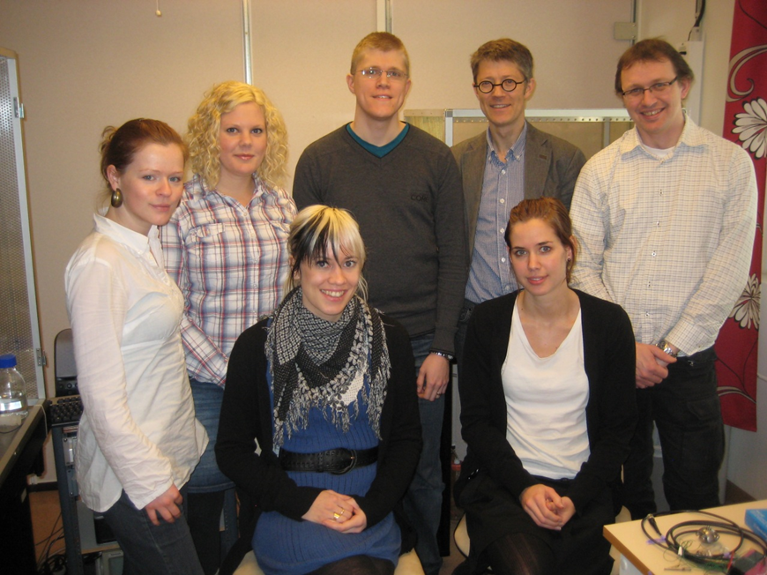
Electrophysiological cell biology and modeling of the heart
Nina
Ottosson
Jakob
Renhorn
Fredrik
Elinder
Johan
Brask
Ulrike
Henrion
Sara
Börjesson
Ulrika
Englund

Slide 2
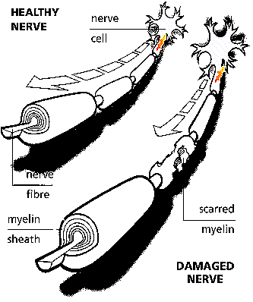
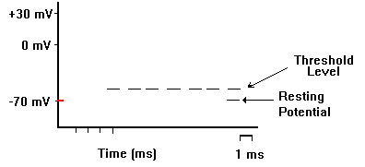
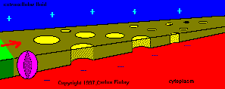
Ion channels generate electrical impulses

Slide 3
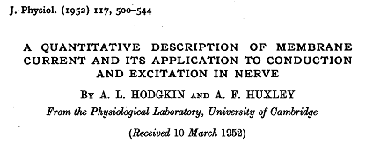
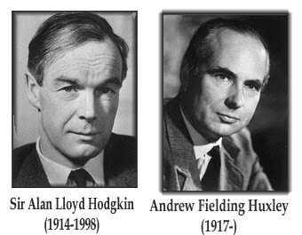

Slide 4
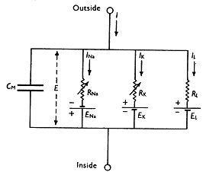
Calculations of ion channel kinetics and action potentials
Equivalent circuit
Leak channel
O
K channel
Na channel
α
α
α
α
4
m
3
m
2
m
1
m
C
↔
C
↔
C
↔
C
↔
O
1
2
3
4
5
β
β
β
β
1
m
2
m
3
m
4
m
α_{h}
β_{h}
α_{h}
β_{h}
α_{h}
β_{h}
α_{h}
β_{h}
α_{h}
β_{h}
α
α
α
α
4
m
3
m
2
m
1
m
I
1
↔
I
2
↔
I
3
↔
I
4
↔
I
5
β
β
β
β
1
m
2
m
3
m
4
m

Slide 5
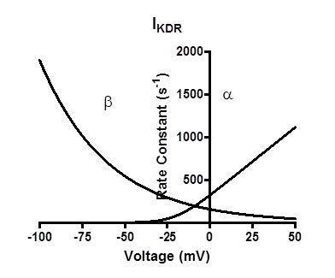
The physical interpretation of transitions
(Eyring rate theory or transition-state theory)
k_{OC}
k_{CO}

Slide 6
Action potential algorithm

Slide 7
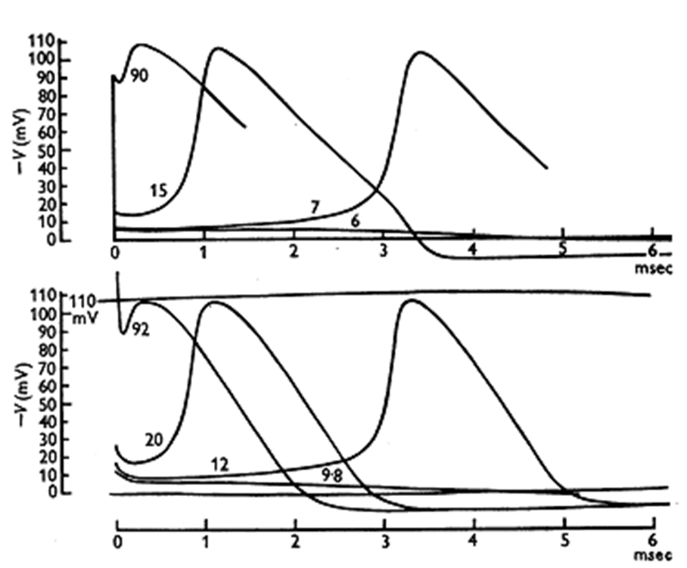
Calculation of action potentials in 1952

Slide 8
General goals
Describe ion channel kinetics with physically sound and molecularly meaningful equations
Use the ion channel kinetics to calculate electrical behaviour of different types of cells
Explore non-linearity from modification of ion channel molecules to changes in excitability of cells, tissues, networks and organs (brain and heart)

Slide 9
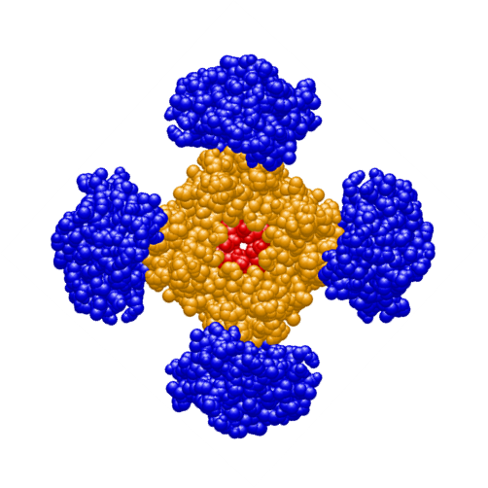
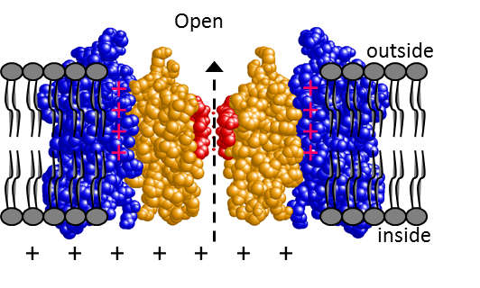
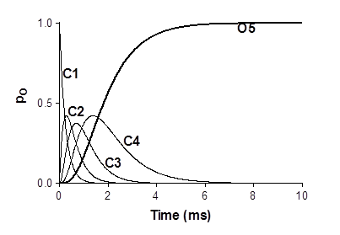
Four voltage sensors acting in parallel make a sigmoidal opening

Slide 11
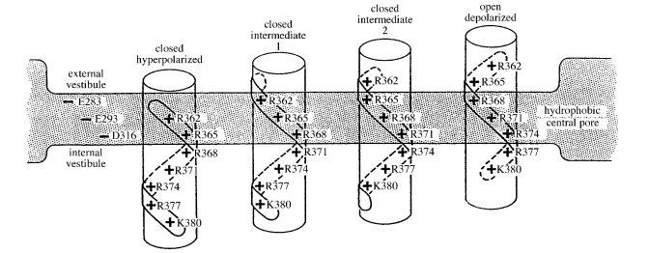
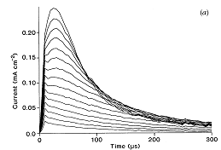
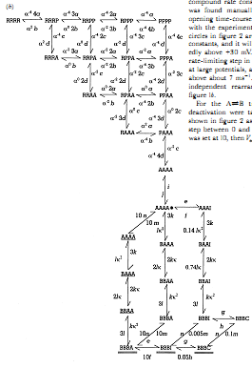
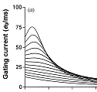
A multi-state model for Na channel gating
Keynes & Elinder, 1998, 1999

Slide 12
Electrical activity in the heart is generated by voltage-gated ion channels
HCN
Na
Ca_{L}
outside
inside
K_{to}
K_{s}
K_{r}
Notes:
Fokus för våra studier är spänningsaktiverade jonkanaler

Slide 13
A two-state HCN channel model can generate unstable rhythmicity
α
C
O
β
α = k exp(-(V+45)/25)
β = k exp(+(V+45)/25)
k = 5/s
k = 500/s

Slide 14
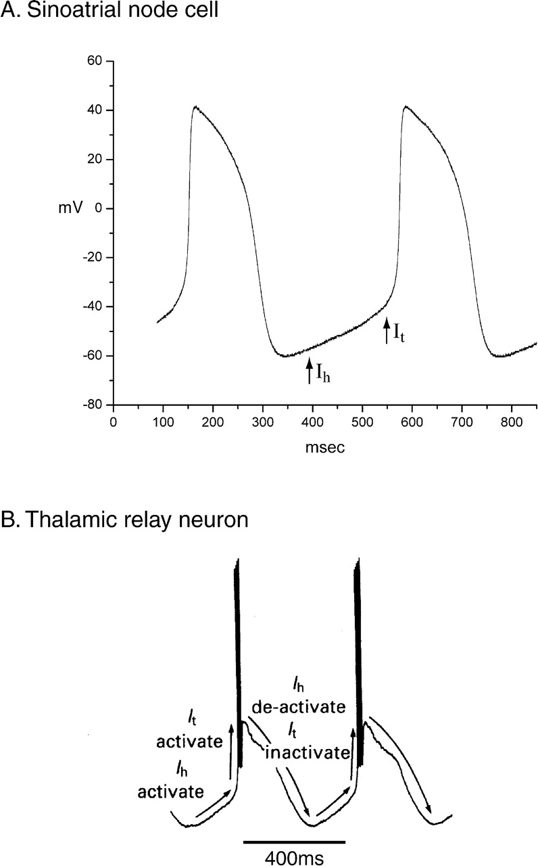
A Four-state model for HCN gating
C_{I}
O_{I}
C_{II}
O_{II}
C_{I}
O_{I}
C_{II}
O_{II}
Männikkö et al., 2002, Nature
Männikkö et al., 2005, J Gen Physiol
Elinder et al., 2006, J Physiol
Bruning-Wright et al., 2007, J Gen Physiol
Notes:
Mkt kort sammanfattning av vårt HCN arbete.

Slide 15
The four-state model prevents cardiac arrhythmia
C
O
C_{I}
O_{I}
C_{II}
O_{II}
k = 5/s
k = 500/s

Slide 16
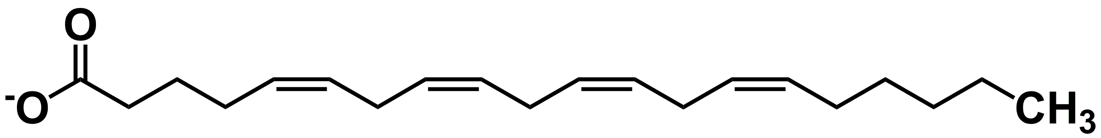
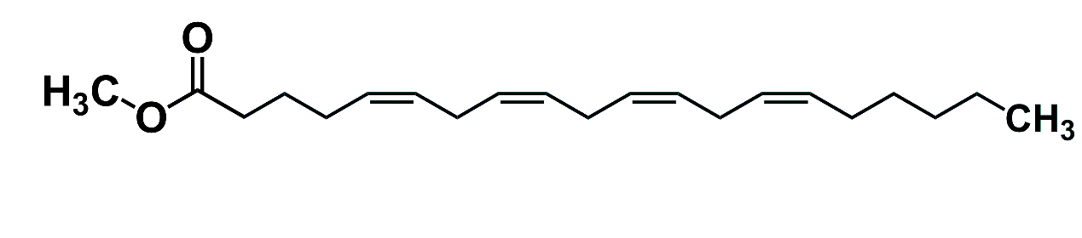
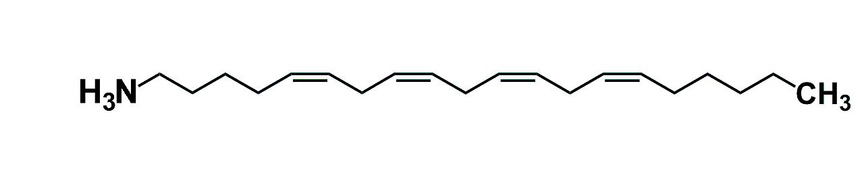
The lipoelectric mechanism in the treatment of epilepsy
+
+
+
+
Arachidonic acid
+
+
+
+
+
+
+
+
+
+
Arachidonic acid-me
+
+
+
+
+
+
+
Arachidonyl amine
+
+
+
+
Börjesson et al., 2008 & 2010, Biophys J
Notes:
-To explain all data, we have developed a model for what we call a lipoelectric mechanism. The model nicely describes our data.
-Now we will jump to the binding site of PUFA

Slide 17
Modification of the voltage sensor movement affects excitability
ΔV = −5 mV
Börjesson et al., 2010, BJ
Notes:
-Nervous impulses can be calculated with relatively simple computer programs, based on the frog myelinated axon by Frankenhaeuser & Huxley.
-Here we induce repetitive firing by injecting a constant current.
-If we increase the number of K channels we abolish this repetitive firing.
-Equivalently, if we change the voltage dependence with 5 mV we also abolish repetitive firing.
-What is the molecular mechanism? To address this question, we used a number of different fatty acid-type substances

Slide 18
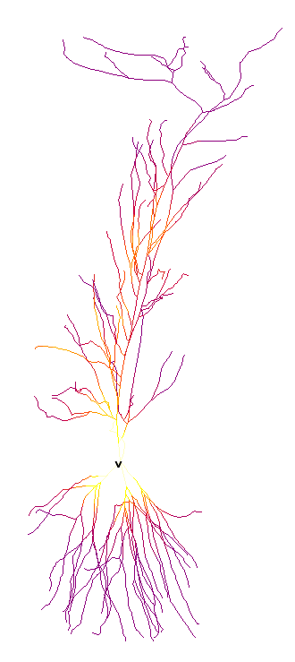
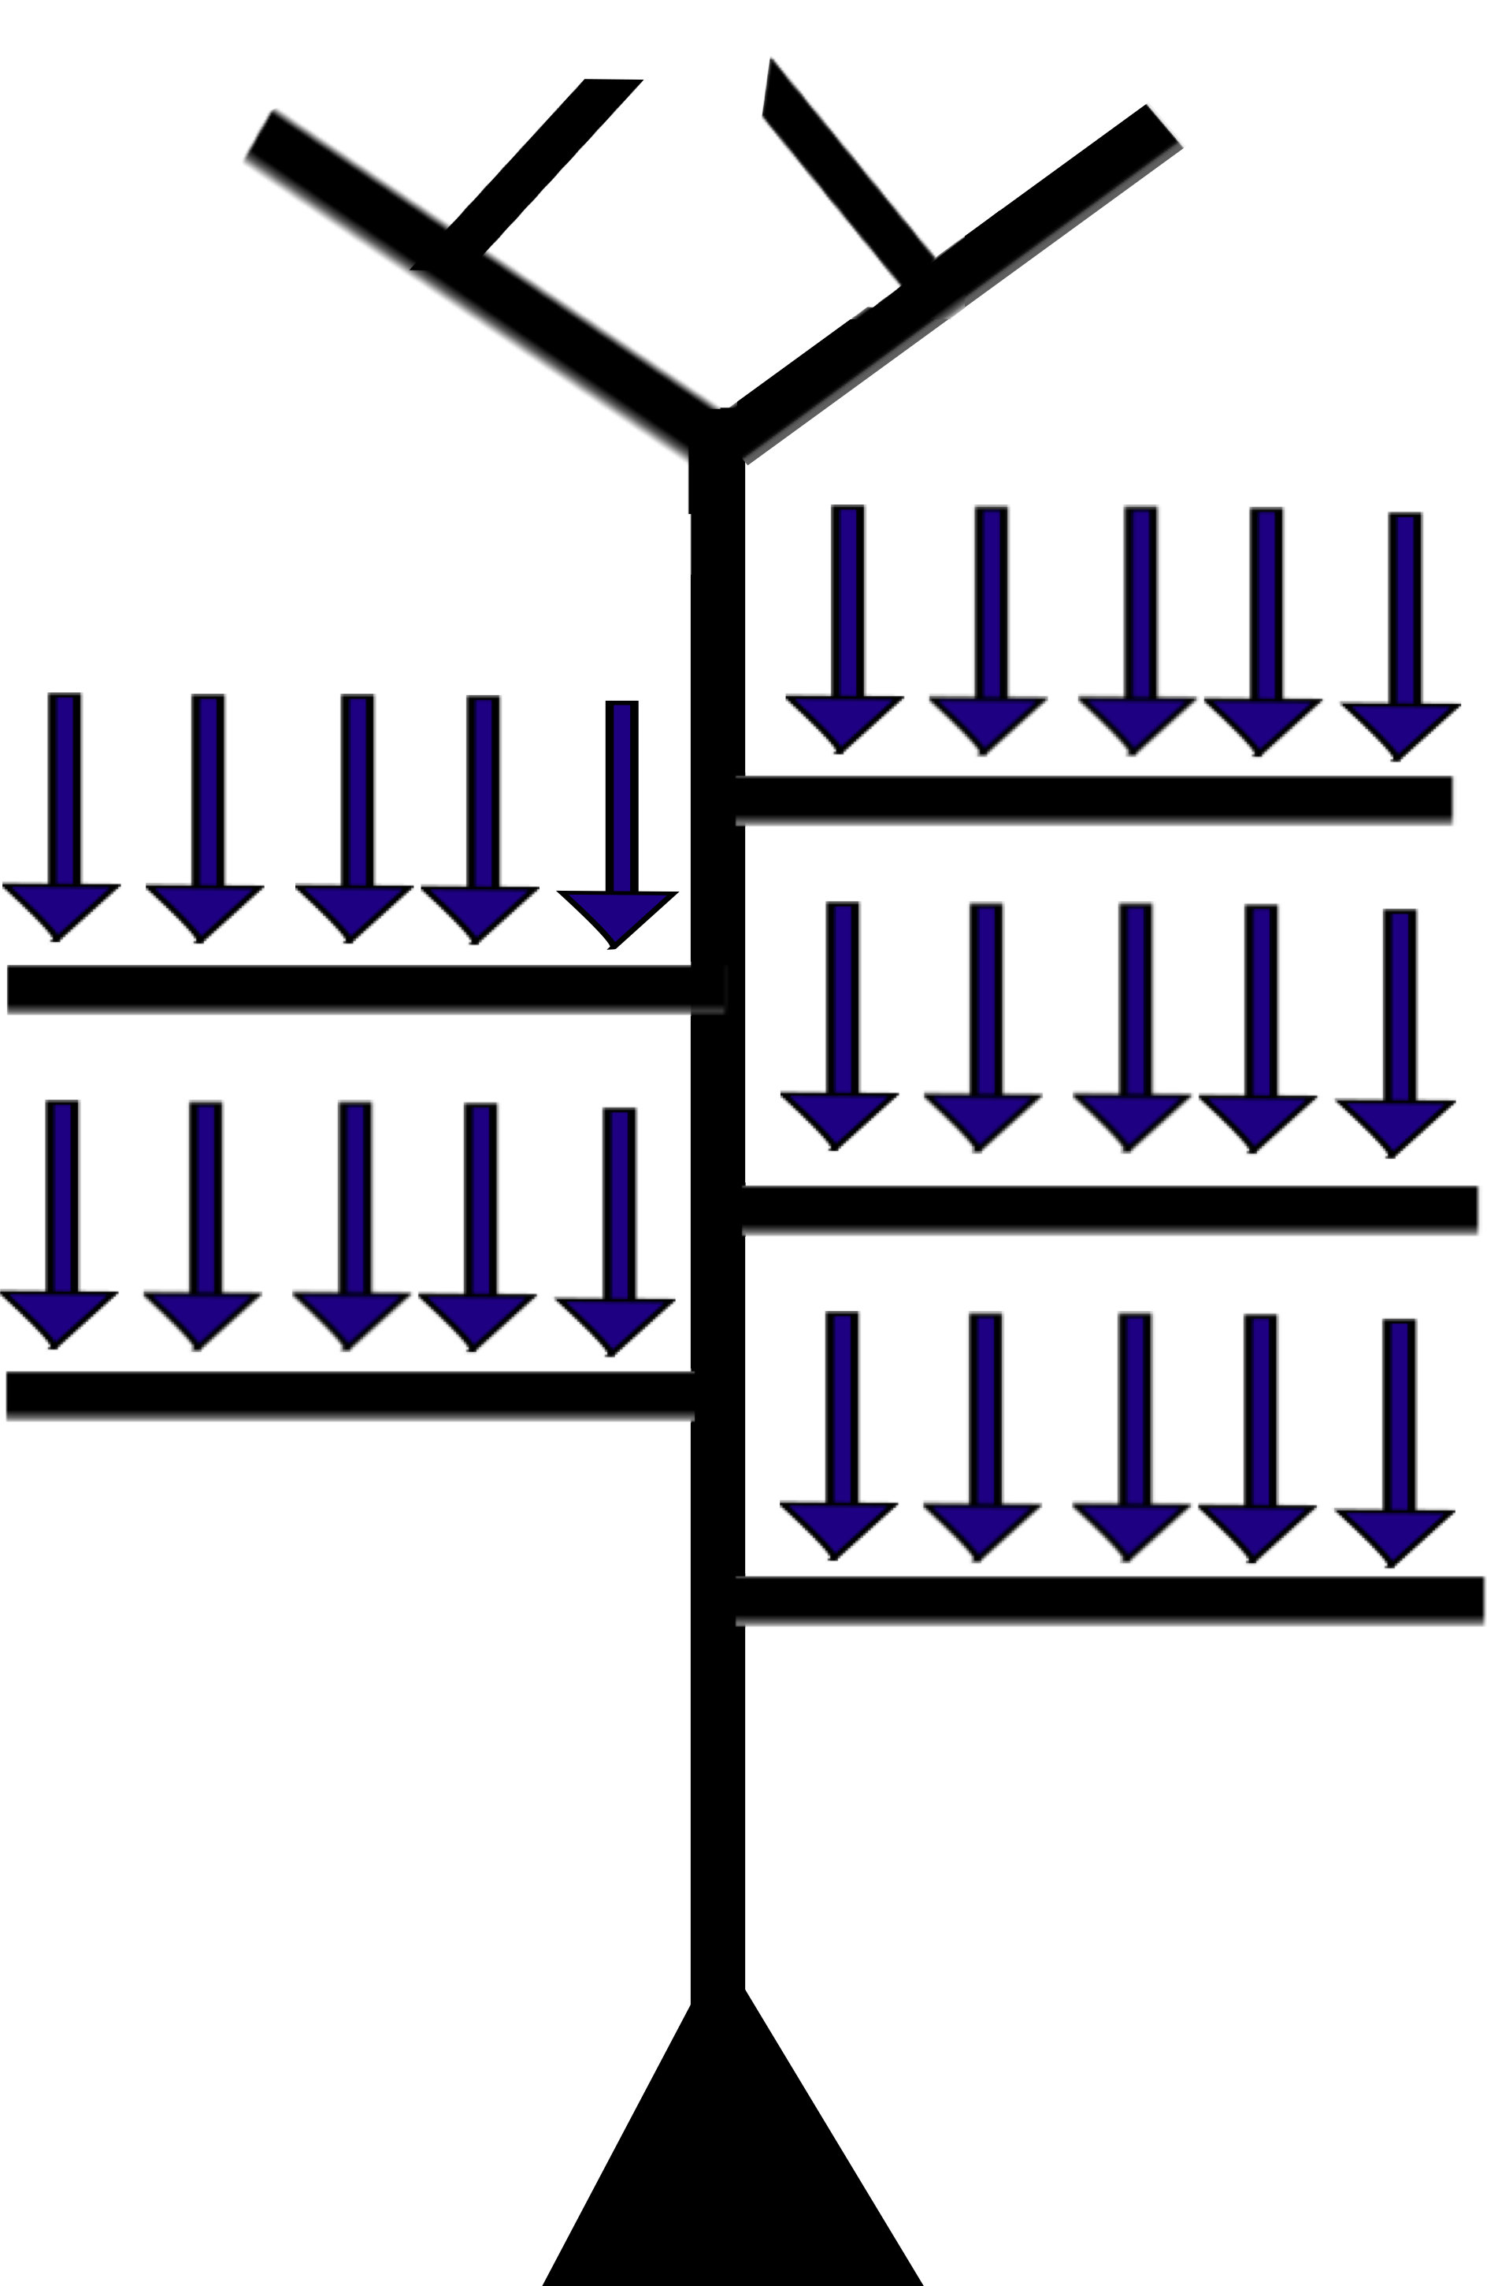
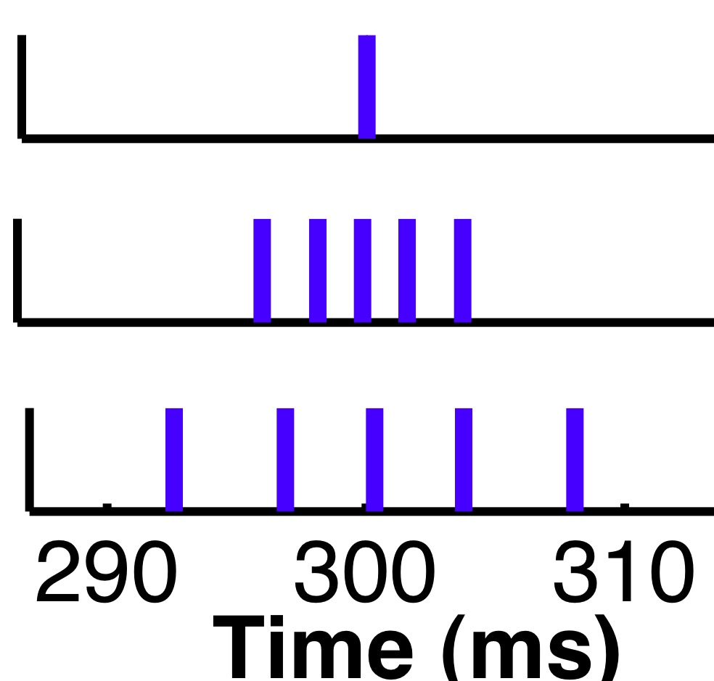
Excitability of hippocampus CA1 neuron
Tigerholm et al., in preparation

